Slide 1
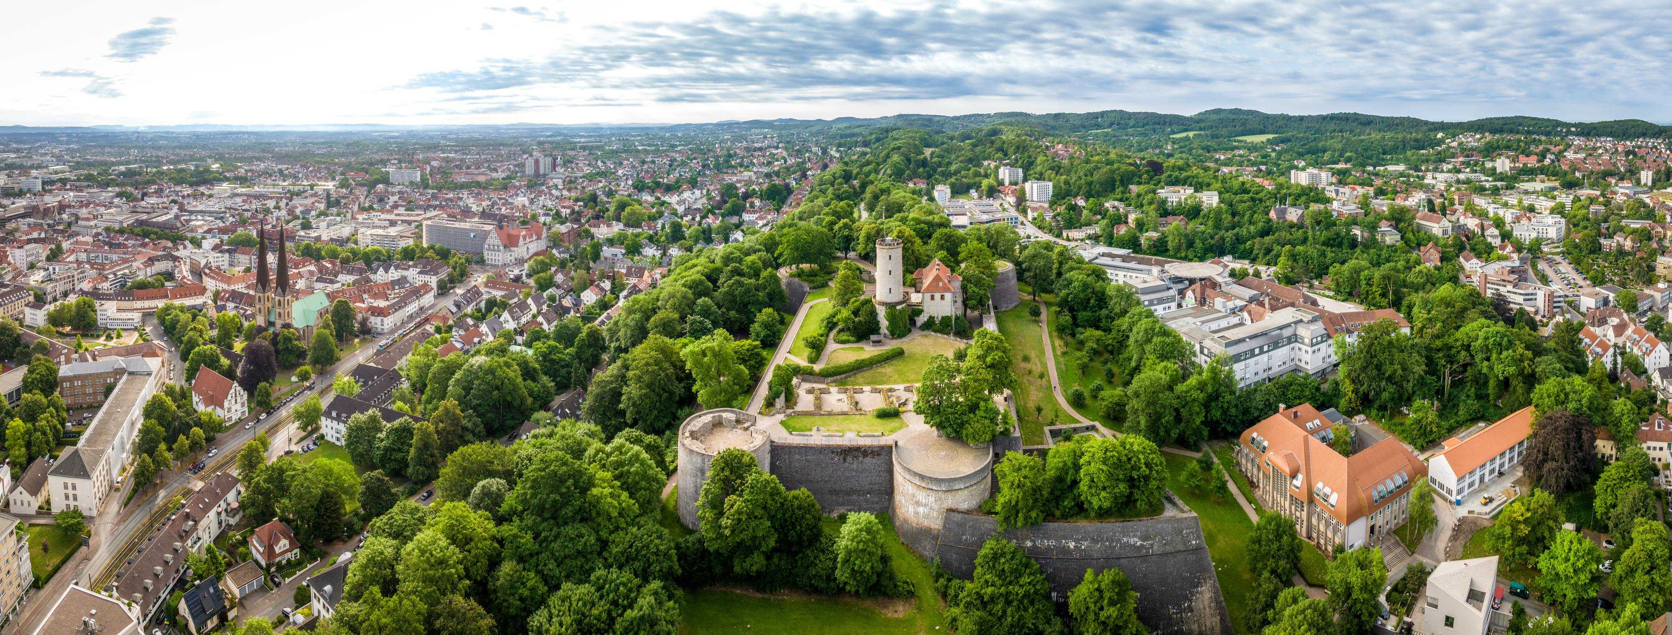
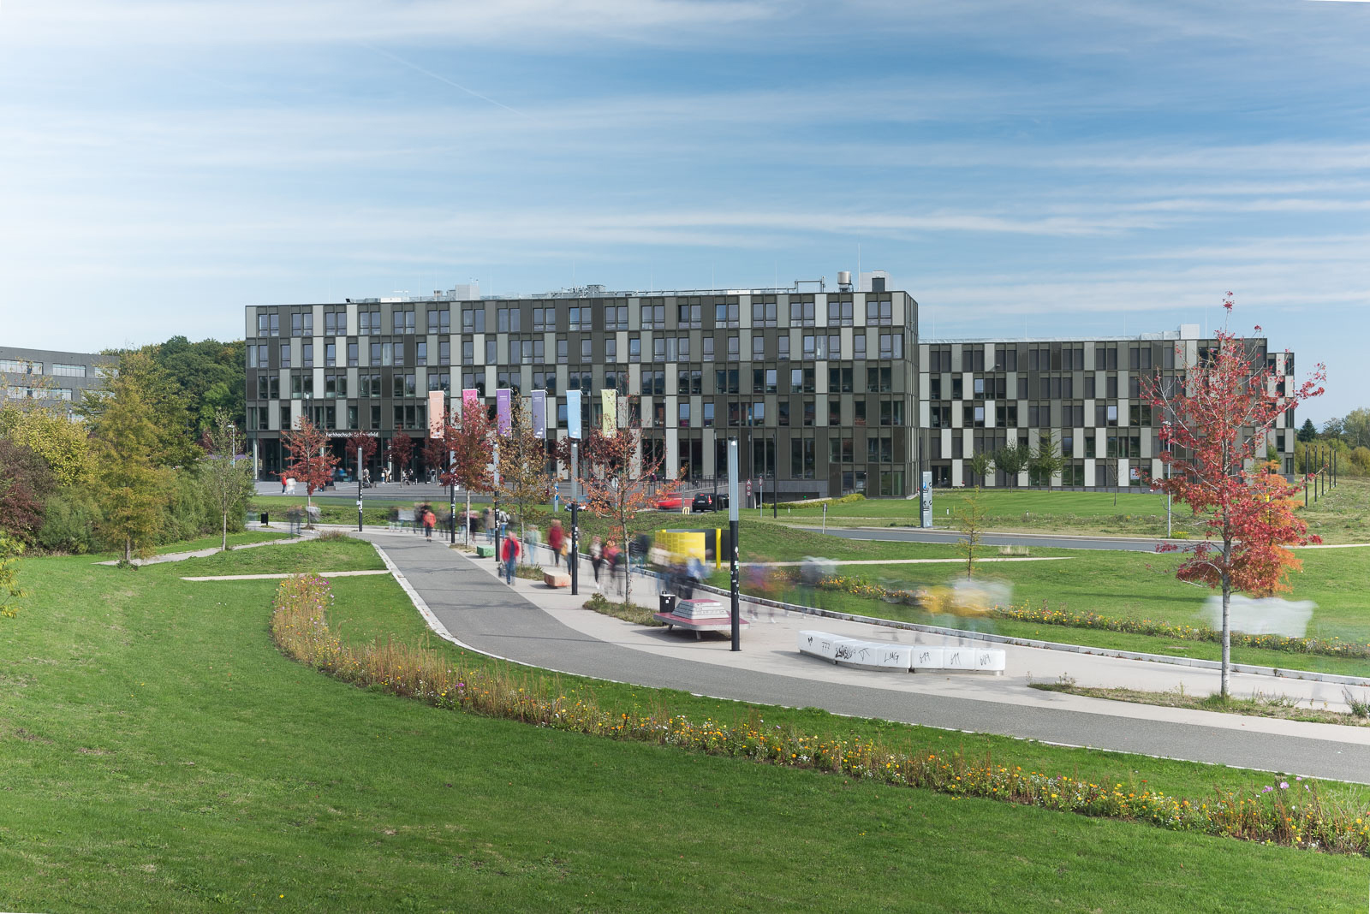


EOOLT 2025 10th International Workshop on Equation-Based Object-Oriented Modeling Languages and Tools
Copyright Teutoburger Wald Tourismus / D. Ketz
The topics covered will range from language design, formal semantics via modeling aspects to generation of simulation code. Contributions can be submitted either as full papers or as 4-page work-in-progress papers.
June 13
Bielefeld, Germany
Submission deadline: April 11
Author notification: May 7
Camera-ready: June 6
General Chair:
Bernhard Bachmann
Hochschule Bielefeld University of Applied Sciences and Arts
Program Chair:
Benoît Caillaud
INRIA Rennes
National Institute for Research in Computer Science and Control
Copyright: HSBI | Andreas Jon Grote
https://eoolt.org

